Slide 1
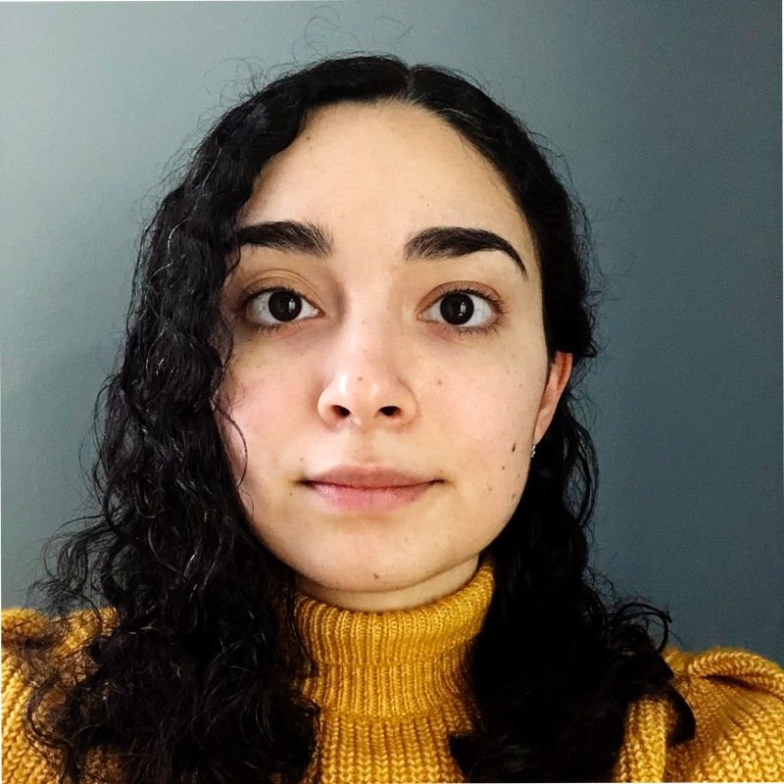
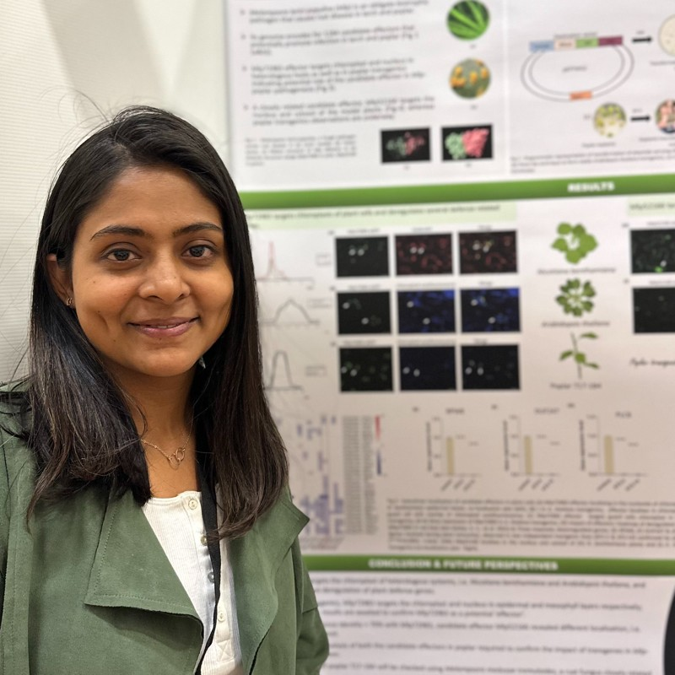
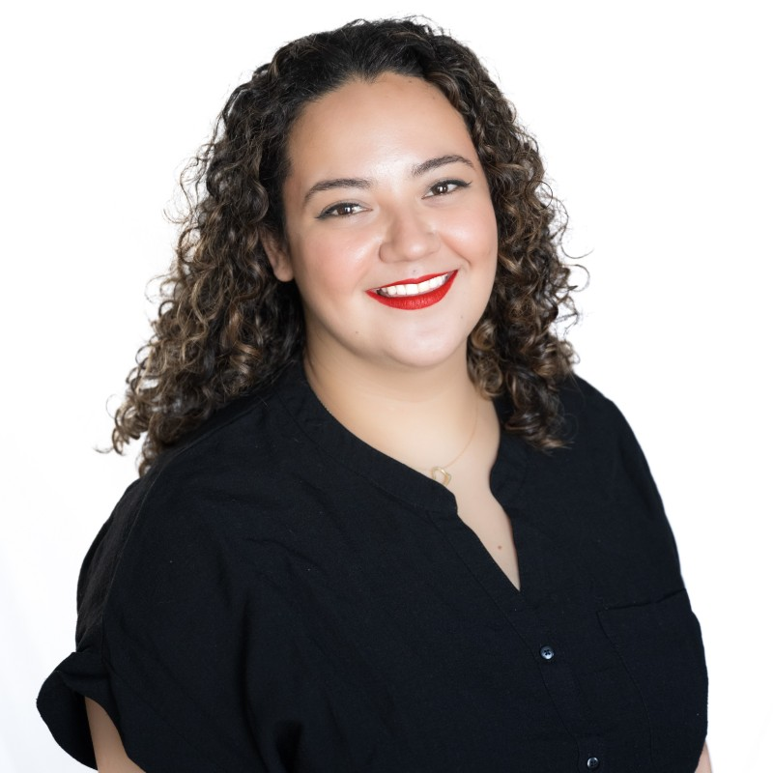
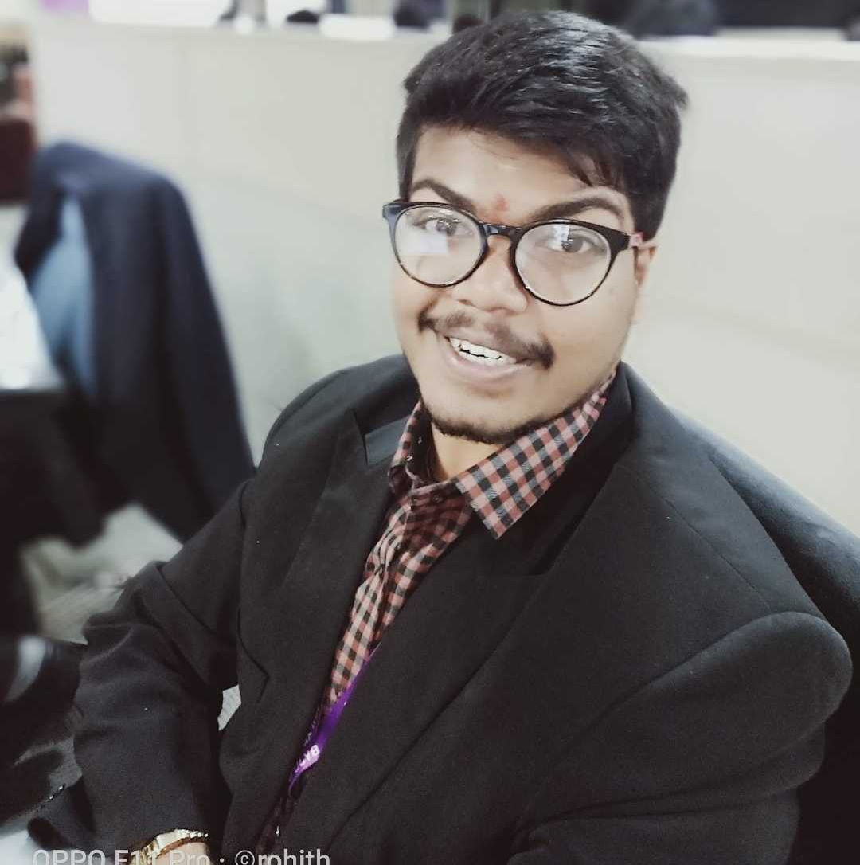
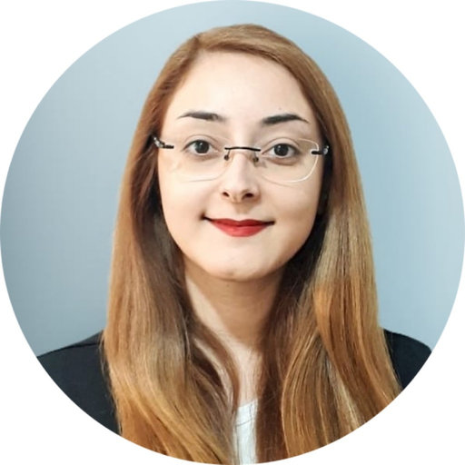
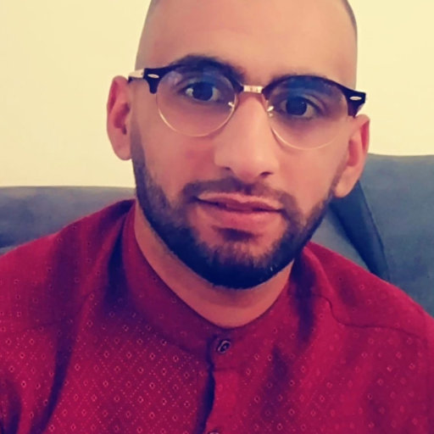
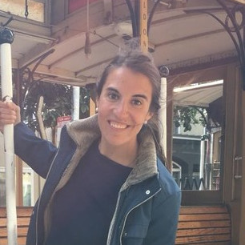
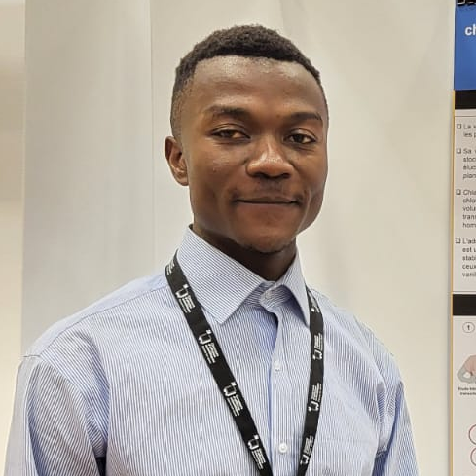
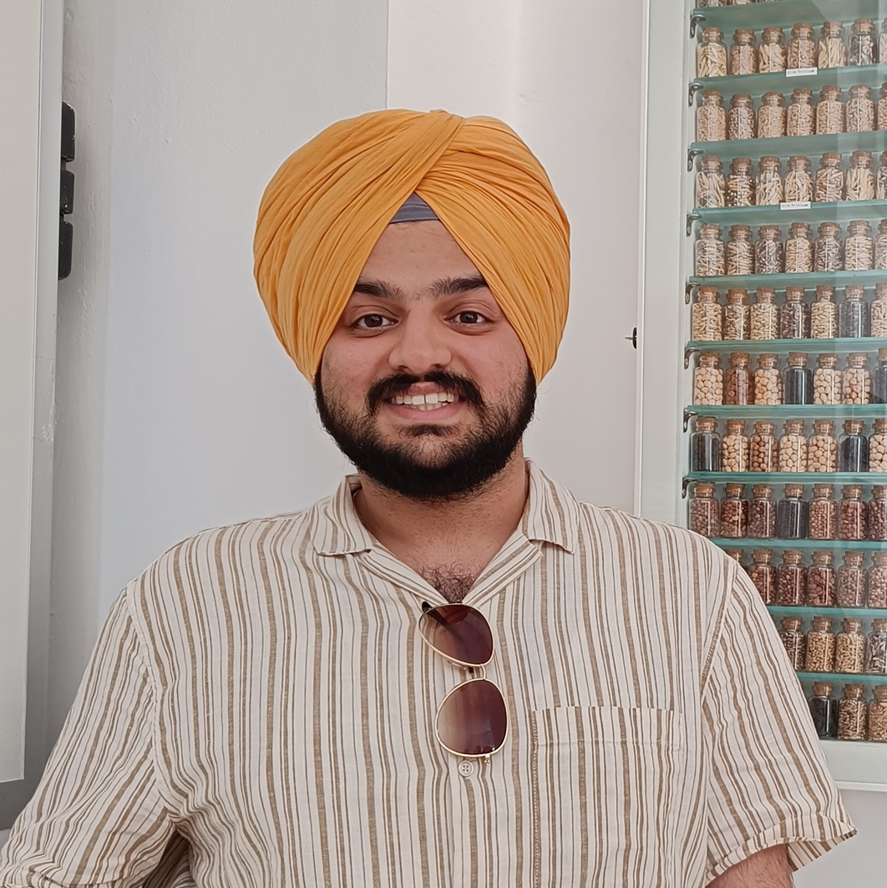
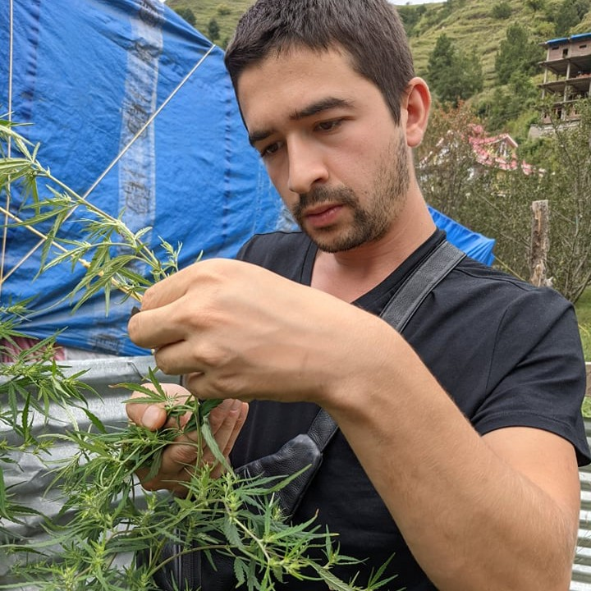
2023
President
Aracely Maribel Diaz Garza
PhD candidate, UQTR
Vice-President
Snehi Gazal
PhD candidate, UQTR
VP Communications
Arghavan Arjmandi
PhD candidate, UQTR
VP Networking
Ayoub Bouhadada
PhD candidate, UQTR
VP Communications
Valeria Parra
Master’s student, UQTR
VP Networking
Rohith Grandhi
PhD student, UQTR
Treasurer
Charlotte Blasi
PhD candidate, UdeS
Secretary
Prabhjot Sanghera
PhD student, McGill
Treasurer
Elisa Ines Fantino
Postdoctoral fellow, UQTR
Secretary
Arnold William Tazon
PhD student, UQTR
Web developer
Karen Cristine Goncalves dos Santos
Postdoctoral fellow, UQTR
Collaborator (VP networking)
Théo Devèze
PhD candidate, UQTR

Slide 2
2023
Présidente
Aracely Maribel Diaz Garza
Candidate au doctorat, UQTR
Vice-Présidente
Snehi Gazal
Candidate au doctorat, UQTR
VP Communications
Arghavan Arjmandi
Candidate au doctorat, UQTR
VP Réseautage
Ayoub Bouhadada
Candidate au doctorat, UQTR
VP Communications
Valeria Parra
Étudiant à la Maitrise, UQTR
VP Réseautage
Rohith Grandhi
Étudiant au doctorat, UQTR
Trésorière
Charlotte Blasi
Candidate au doctorat, UdeS
Secrétaire
Prabhjot Sanghera
Étudiant au doctorat, McGill
Trésorière
Elisa Ines Fantino
Postdoctoral fellow, UQTR
Secrétaire
Arnold William Tazon
Étudiant au doctorat, UQTR
Web developer
Karen Cristine Goncalves dos Santos
Postdoctoral fellow, UQTR
Collaborateur (VP Réseautage)
Théo Devèze
Candidate au doctorat, UQTR

